Slide 1
Part - V
Cloud Issues:
Stability
Partner Quality
Longevity
Business Continuity
Service-level Agreements
Agreeing on the service of clouds
Solving Problems
Quality of service
Regulatory Issues and Accountability

Slide 2
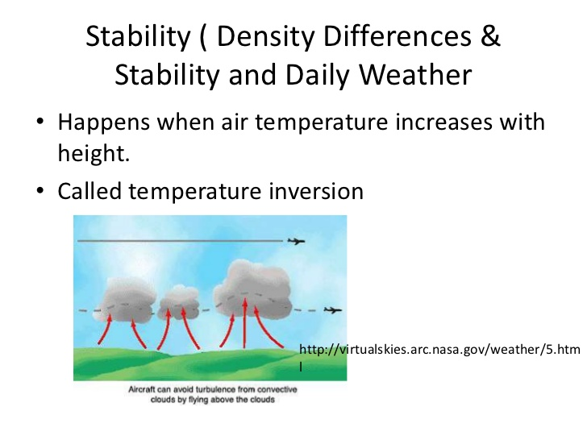
Stability

Slide 3
1) Atmospheric Stability is measure by comparing the temperature of a rising (sinking) parcel to the surrounding air (or environmental) temperature. When a rising or sinking parcel exchanges no heat with its environment, this is known as an Adiabatic process.
How the temperature changes with altitude is referred to as the lapse rate.
There are three important lapse rates to know:
2) Environmental Lapse Rate (ELR) - describes how the air temperature changes with altitude on any give day at any given time. It is continually changing.
3) Dry adiabatic lapse rate (DALR): If the specific humidity of the parcel does not change (in other words there is no condensation or evaporation) the temperature of a rising air parcel decreases approximately 10C per 1000m increase in altitude.

Slide 4
4) Moist adiabatic lapse rate (MALR): If the rising air is saturated then the parcel's temperature decreases because of expansion; however, condensation (deposition) releases heat and so the parcel's temperature does not cool as much as if condensation did not occur. The MALR is not constant but for our purposes we will assume it is a constant value of 6C per 1000m.
The stability of a layer in the atmosphere is characterized as either:
i) Absolutely Stable: ELR is less than the moist adiabatic lapse rate
ii) Absolutely Unstable: ELR is greater than the dry adiabatic lapse rate
iii) Conditionally Unstable: ELR between DALR and MALR.

Slide 5
Partner Quality
We are seeing such an eco system developed in cloud computing space where cloud enablers and solution providers are hard at work collaborating to get their solutions and platforms ready for the wave of growth that’s coming in the future.
In this system various partner entities like Cisco, NetApp and Vmware bring their technologies and products together and back this with their combined strength in integration, technology consulting, services sales and marketing.

Slide 6
Longevity
Longevity is an operational testing scheme that uses a baseline work efficiency specification to evaluate large enterprise application and hardware performance.
This testing is applied for error checking or heavy usage after a live operational period and is contingent on complexity and size.

Slide 7
Business Continuity
Clouds vary by scope and location.
Ownership describes who manages the cloud:
Internal (managed by your company)
External (managed by a third party)
Scope describes how resources are allocated in the cloud among the different tenants:
Dedicated: Individual servers are exclusively allocated per tenant.
Shared: Individual servers have multiple tenants allocated (the cloud owner manages aggregate capacity). This is less expensive than dedicated because of the ability of the cloud owner to utilize unused capacity for other tenants.
Hybrid: Tenants can choose between utilizing a fully dedicated environment or a shared environment.

Slide 8
Business Impact Analysis (BIA)
During the business impact analysis, it’s critical to identify ‘third party’ and ‘hosted’ applications, along with who procured the application. Cloud applications are frequently purchased outside of IT and thus not on established application listings. The focus at this point should be to identify these services and determine how critical they are based on requested recovery time objectives.
Recovery Strategy
If critical cloud services are identified during the BIA, it is important to evaluate and then select appropriate recovery strategies. In some ways you can leverage any existing processes used for vendor assessments, but there are a couple distinctions:
SLAs with financial penalties are important, but not a comprehensive solution, because most penalties are small (limited to 1 month’s fees) compared to the impact of a critical application being down for an extended period.

Slide 9
Plan Development
When you start building business continuity plans for the groups that utilize cloud services, there are a few considerations to keep in mind:
Document manual workarounds (if available) for when the application is inaccessible.
Document key contacts for the cloud service, including the support desk, account manager, and the address of any websites that display the status of the service.

Slide 10
Service Level Agreements (SLA)
A service-level agreement (SLA) is defined as an official commitment that prevails between a service provider and a client. Particular aspects of the service – quality, availability, responsibilities – are agreed between the service provider and the service user.
The most common component of SLA is that the services should be provided to the customer as agreed upon in the contract.

Slide 11
SLAs establish customer expectations with regard to the service provider's performance and quality in a number of ways. Some metrics that SLAs may specify include:
Availability and uptime -- the percentage of the time services will be available.
Specific performance benchmarks to which actual performance will be periodically compared.
Application response time.
The schedule for notification in advance of network changes that may affect users.
Help desk response time for various classes of problems.
Usage statistics that will be provided.

Slide 12
Service level agreements are also defined at different levels:
1) Customer-based SLA: An agreement with an individual customer group, covering all the services they use. For example, an SLA between a supplier (IT service provider) and the finance department of a large organization for the services such as finance system, payroll system, billing system, procurement/purchase system, etc.
2) Service-based SLA: An agreement for all customers using the services being delivered by the service provider. For example:
A mobile service provider offers a routine service to all the customers and offers certain maintenance as a part of an offer with the universal charging.

Slide 13
3) Multilevel SLA: The SLA is split into the different levels, each addressing different set of customers for the same services, in the same SLA.
  Corporate-level SLA: Covering all the generic service level management (often abbreviated as SLM) issues appropriate to every customer throughout the organization. These issues are likely to be less volatile and so updates (SLA reviews) are less frequently required.
  Customer-level SLA: covering all SLM issues relevant to the particular customer group, regardless of the services being used.
  Service-level SLA: covering all SLM issue relevant to the specific services, in relation to this specific customer group.

Slide 14
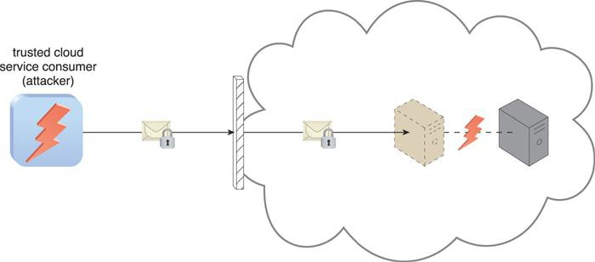
Virtualization Attack
Figure 6.13 An authorized cloud service consumer carries out a virtualization attack by abusing its administrative access to a virtual server to exploit the underlying hardware.

Slide 15
Overlapping Trust Boundaries
If physical IT resources within a cloud are shared by different cloud service consumers, these cloud service consumers have overlapping trust boundaries.
Malicious cloud service consumers can target shared IT resources with the intention of compromising cloud consumers or other IT resources that share the same trust boundary.

Slide 16
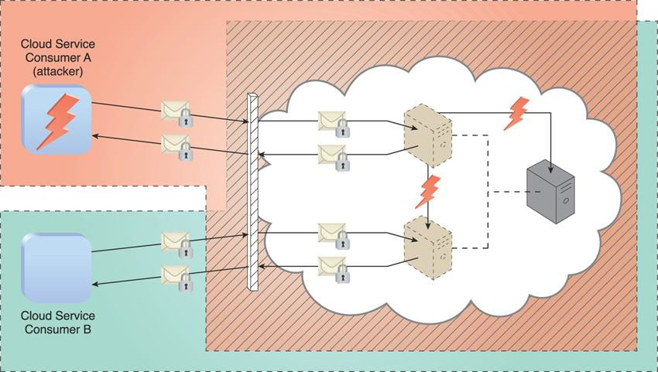
Overlapping Trust Boundaries
Figure 6.14 Cloud Service Consumer A is trusted by the cloud and therefore gains access to a virtual server, which it then attacks with the intention of attacking the underlying physical server and the virtual server used by Cloud Service Consumer B.

Slide 17
Additional Considerations
Cloud consumers need to be aware that they may be introducing security risks by deploying flawed cloud-based solutions.
An understanding of how a cloud provider defines and imposes proprietary, and possibly incompatible, cloud security policies is a critical part of forming assessment criteria when choosing a cloud provider vendor.

Slide 18
Additional Considerations
Liability, indemnity, and blame for potential security breaches need to be clearly defined and mutually understood in the legal agreements signed by cloud consumers and cloud providers.
It is important for cloud consumers, subsequent to gaining an understanding of the potential security-related issues specific to a given cloud environment, to perform a corresponding assessment of the identified risks.

